Slide 1





PRESENTATION 2026
Student Name
Student Email
Sneha Pahwa
snehapahwa124@gmail.com
Mentor Name
Ankit Dixit

Slide 2

Outline
Abstract of the Project
Problem Statement
Proposed Solution
System Architecture
Live Demo of the Project
Embedded Video of Project
Conclusion
Future Scope

Slide 3
Abstract
The project “Smart Payroll Insights: Transforming HR Data into Financial Intelligence” aims to clean, analyze, and convert payroll data into meaningful financial insights.
The objective is to improve payroll accuracy, transparency, and decision-making in HR and finance.
Tools used include Microsoft Excel for data cleaning and analysis, Power BI for visualization, and AI tools like Chatgpt for automation and insight generation.
The project helps identify salary trends, payroll expenses, and data errors, enabling better financial planning and workforce management.
A key highlight is the integration of AI with traditional tools to create an efficient, data-driven payroll analysis system.

Slide 4

Problem Statement
Core Problem: Unstructured and error-prone payroll data limits accurate analysis and decision-making.
Significance: Leads to salary errors, compliance risks, and reduced employee trust.
Affected Users: HR teams, finance departments, employees, and management.
Limitations: Manual processes, low transparency, and limited use of analytics/AI tools.
Scope: Focus on data cleaning, analysis, and visualization using Excel, Power BI, and AI tools (no advanced ML or real-time systems).

Slide 5

Proposed Solution
Approach: Transform raw payroll data into structured
financial insights using data cleaning, analysis, and visualization.
Methodology: Data collection → cleaning
(remove duplicates, handle missing values)
→ analysis (formulas) → dashboard creation.
Tools Used: Microsoft Excel, Power BI, and AI tools (Chatgpt).
Key Steps: Data preprocessing, payroll analysis, trend identification,
and interactive dashboard development.
Benefits: Improved accuracy, better transparency, reduced errors,
and data-driven decision-making.
Innovation: Integration of AI tools with traditional Excel-based
analysis for faster and smarter insights.

Slide 6
System Architecture
Data Input / Source
Processing / Analysis
Raw payroll dataset generated using ChatGPT
Dataset stored in Excel format
Fields include: Department, Job Role, Designation, Basic Pay, allowances, Gross salary Deductions, Net Salary
Used as the primary data source for payroll analysis
Data cleaned in Excel (duplicates removed, missing values handled)
Data types corrected (numeric fields formatted properly)
Calculated measures created in Power BI using DAX:
Total Payroll Cost
Average Salary
Data aggregated for department-wise and role-wise analysis
AI / Tool Integration
Output / Dashboard
ChatGPT used to generate and structure the dataset
Excel used for initial data cleaning and preprocessing
Power BI used for data modeling and visualization
DAX used for KPI calculations and insights generation
Interactive Power BI Dashboard created
KPIs displayed: Total Payroll Cost, Total Employees,
Average Salary
Visuals include:
Department-wise Payroll (Clustered Column Chart)
Top Departments by Cost
Slicers added: Department, Designation

Slide 7
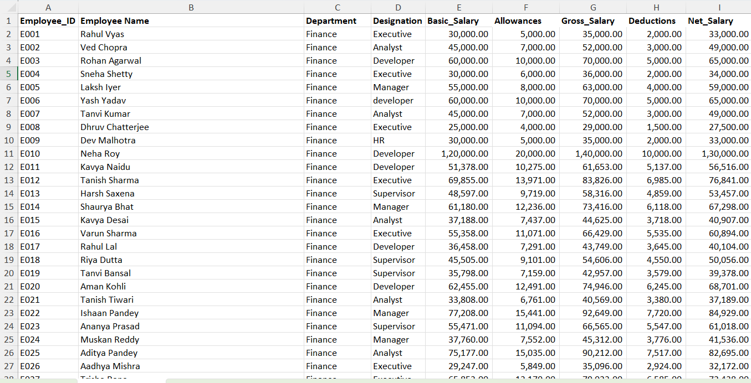
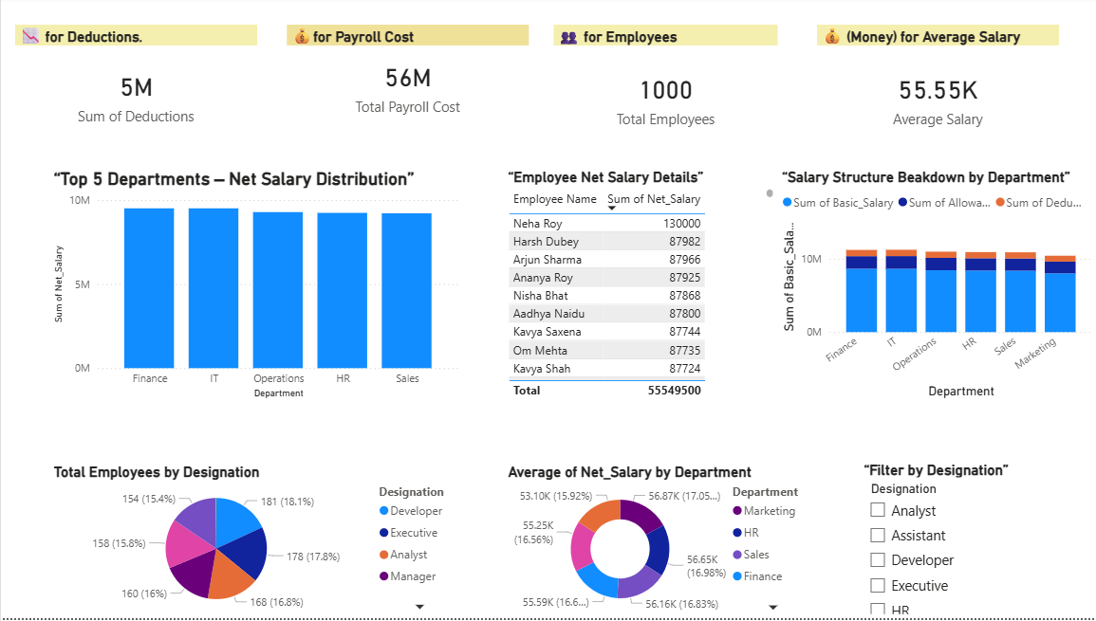
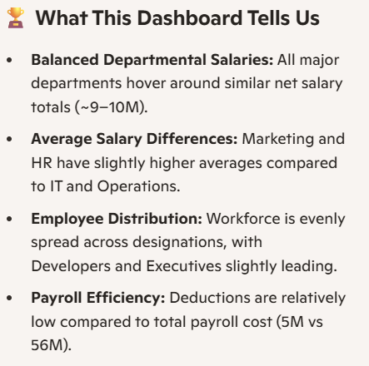
Live Demo of Project
Here's the list of some demo screenshots / features of the project:
Demo 1
Demo 2
Demo 3

Slide 8
Video of Project Demo
[https://your-project-demo-link.com]
▶
[Insert your project demo video.
You can embed a video your live project.]

Slide 9
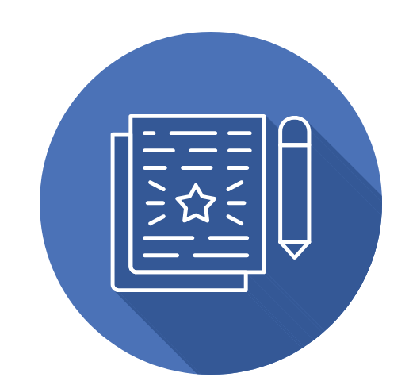
Conclusion
This project developed an interactive payroll dashboard using Excel and Power BI to analyze employee salary data.
Key KPIs like Total Payroll Cost, Average Salary, and Total Employees were created, along with visualizations for department-wise analysis.
The dashboard helps identify high-cost areas and supports better decision-making. Overall, the project successfully achieved its objectives and demonstrates the value of data analytics in improving payroll management and organizational planning.
CONCLUSION

Slide 10
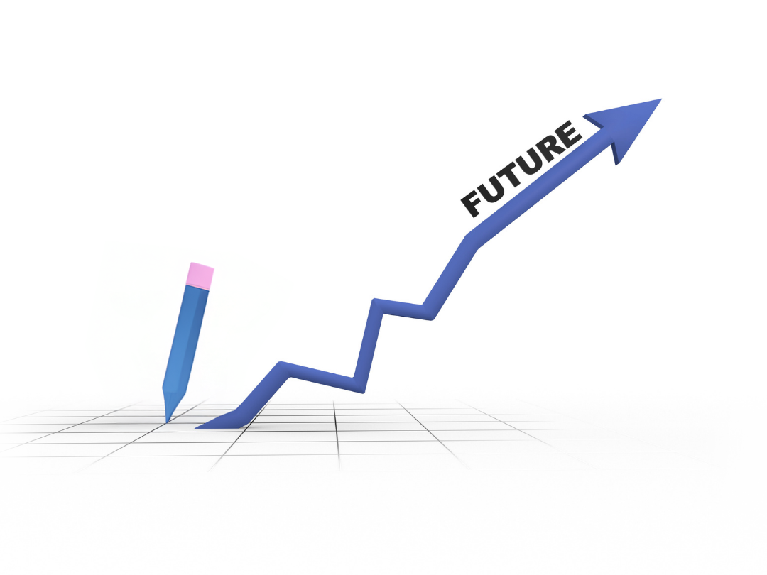
Future Scope
The project can be enhanced by integrating real-time HR data for automatic updates and adding predictive analytics to forecast payroll trends. Additional features like detailed employee attributes and role-based dashboards can improve analysis. Integration with AI for natural language queries and deployment on cloud platforms can further increase scalability, accessibility, and usability.

Slide 11
Thank You
AICW Fellowship | Student Project Presentation 2026
LinkedIn | Edunet Foundation

